Slide 1
Demand Forecasting Data Scientist Challenge
Carlos Espeleta

Slide 2
Agenda
Dataset
Orders: how to clean outliers
Temperature: how to deal with missing values
Marketing spend: how to model marketing campaigns
Seasonality analysis
Cross validation setup
Prediction intervals
Model performance and cross validation predictions
Predictions on the test set

Slide 3
Exploratory Data Analysis

Slide 4
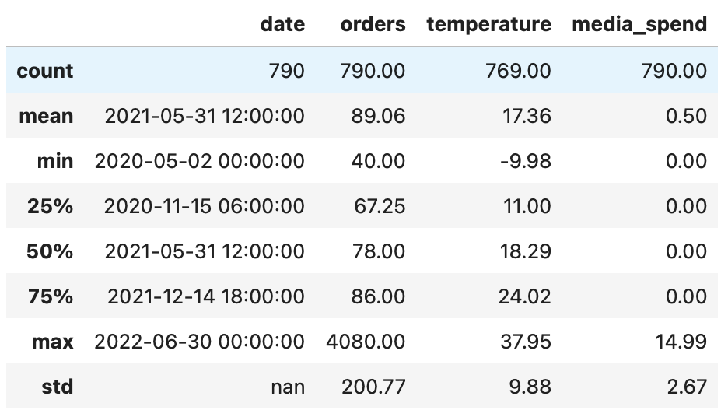
Dataset
Contains 4 variables and 790 observations
First observations
Date: daily frequency, from May 2020 to June 2022
Orders: positive values, with extreme values
Temperature: there are negative and positive values. Contains missing values.
Marketing: this variable contains many zeros

Slide 5
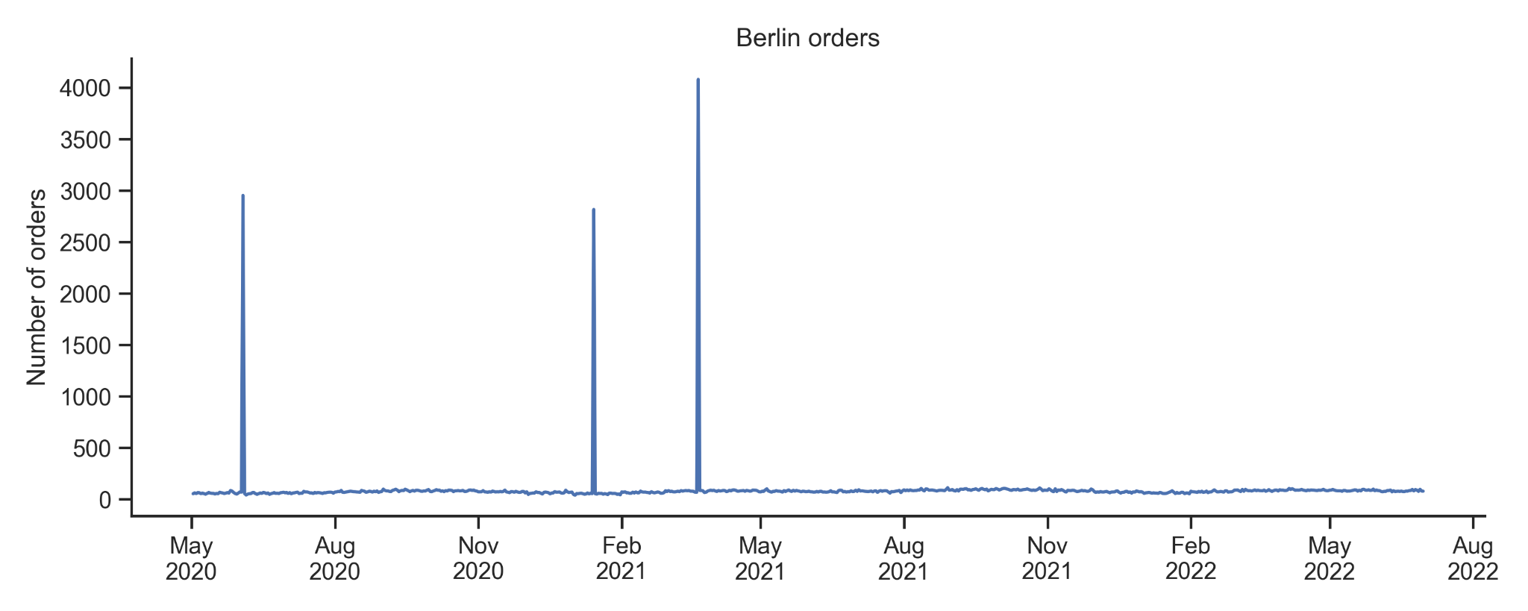
Orders
Contain 3 extreme points
Outliers

Slide 6
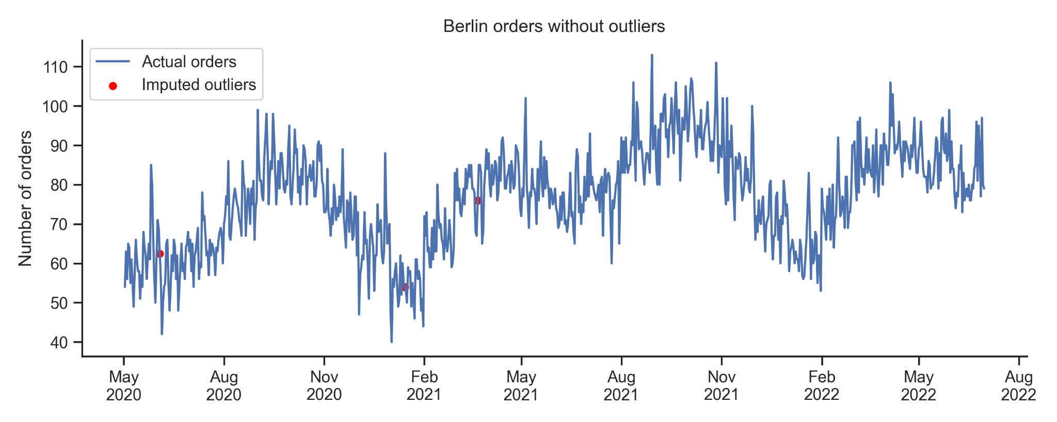
Orders
After removing outliers
Outliers

Slide 7
Outliers identification and correction
This is a two step approach, first identify outliers and then treat them
Understand why there are outliers:
Is it because of a problem in our ETL?
Is it because of a marketing campaign? In this case the impact seems to be to high.
Is it because of an special event?
Is it because a direct competitor of Wolt had problems in Berlin and Wolt received more orders than expected?
The approach followed in this exercise:
Manual identification of the outliers
Correct outliers with a linear interpolation
Alternative approaches:
Rolling standard deviation, quantiles
Time series decomposition

Slide 8
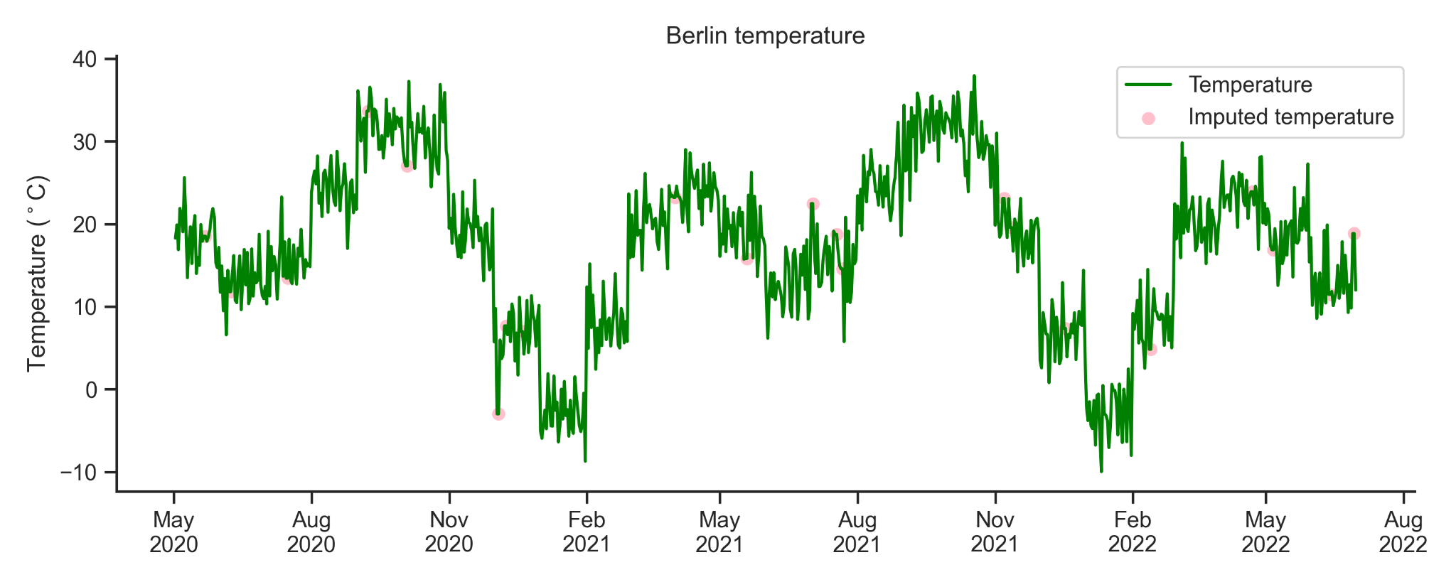
Temperature with missing values imputed
Missing values have been imputed using fill-forward method
The average temperature of a city has a gradual transition, that is, it does not change abruptly from one day to the next. For that reason, missing values have been imputed using previous day's value.
Notes:
Other methods to impute missing values: delete observations, using covariates to predict the value, etc.
Understand why there are missing values:
Is it because of a problem in our ETL?
Is it because of a provider problem?

Slide 9
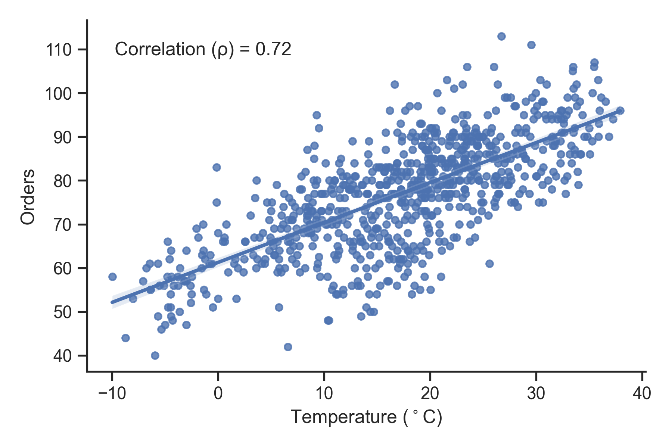
Correlation between orders and temperature
I would expect higher number of orders when temperatures are low

Slide 10
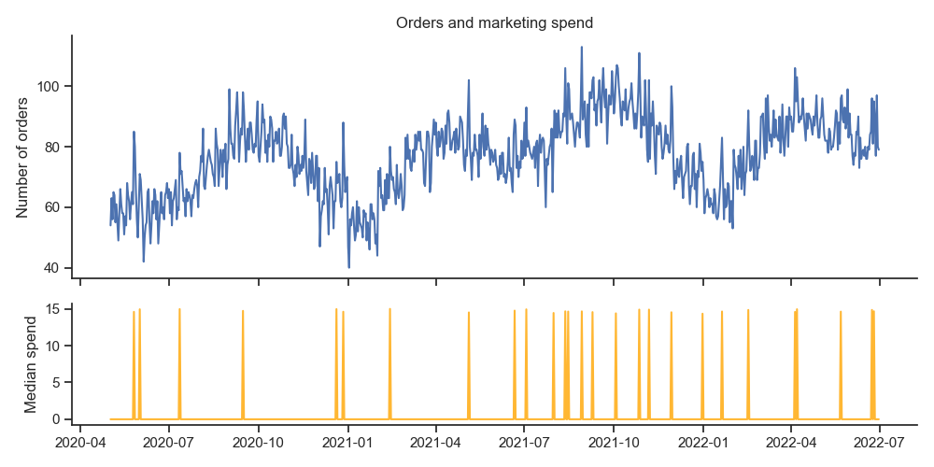
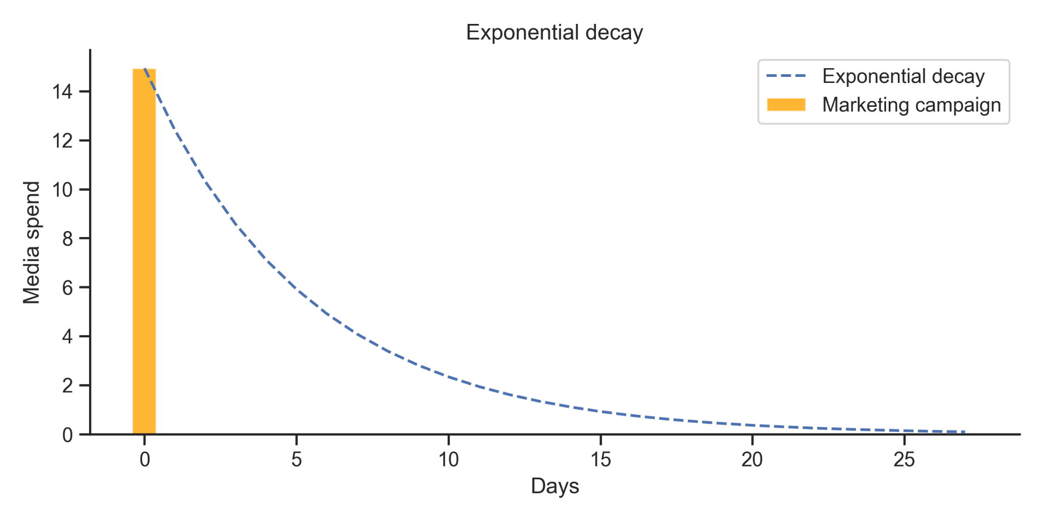
Marketing
Modeling marketing events as exponential decay
Things to consider when modeling a marketing campaign:
There is a time lag between the campaign and its effect.
The effect of the campaign lasts over time

Slide 11
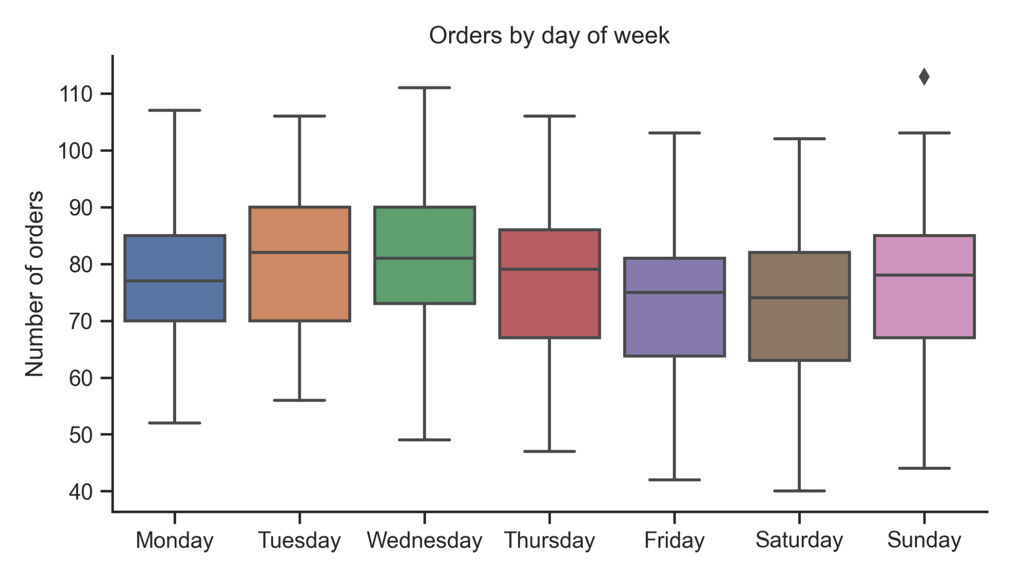
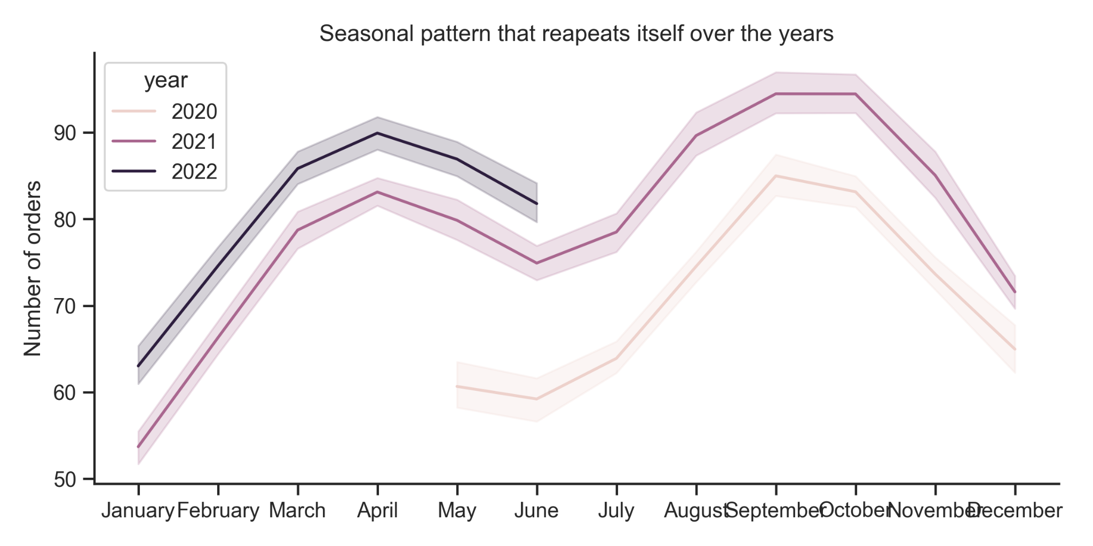
Seasonality
Patterns that are repeated over time
Weekly seasonality
Monthly seasonality

Slide 12
Modeling

Slide 13
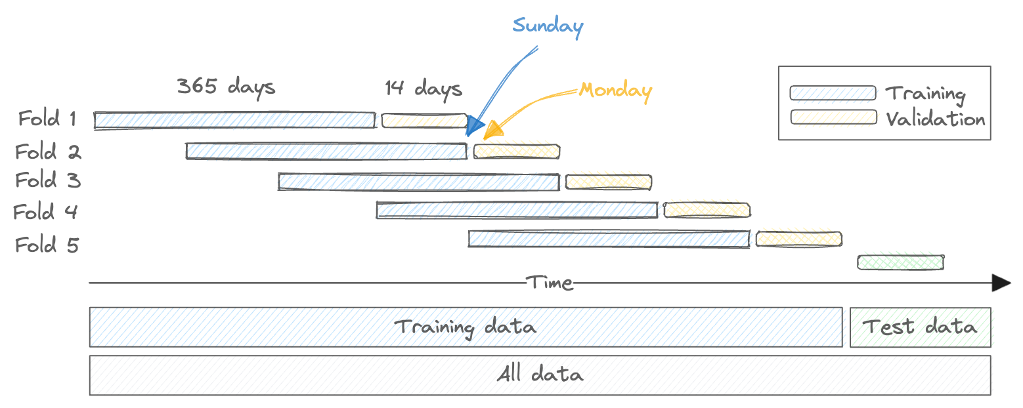
Time series split and cross validation setup
Data is splitted according to time

Slide 14
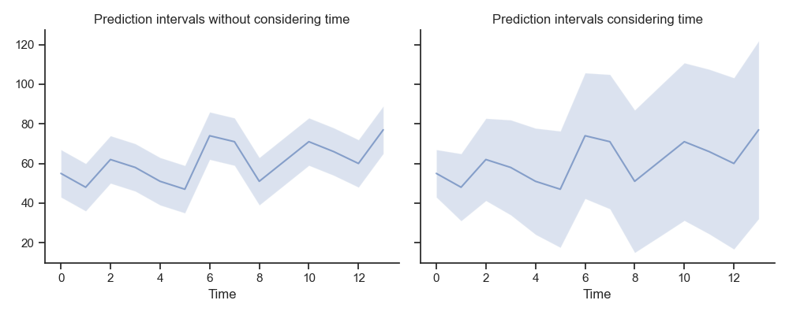
Prediction intervals
Provide uncertainty of point estimates
Process to generate intervals:
Model cross validation
Make out-of-fold predictions
Compute residuals
Bootstrap residuals with replacement
Calculate median of the samples
Calculate standard deviation of medians
Include time dependent component as:
y_pred +/- std * sqrt(t)

Slide 15
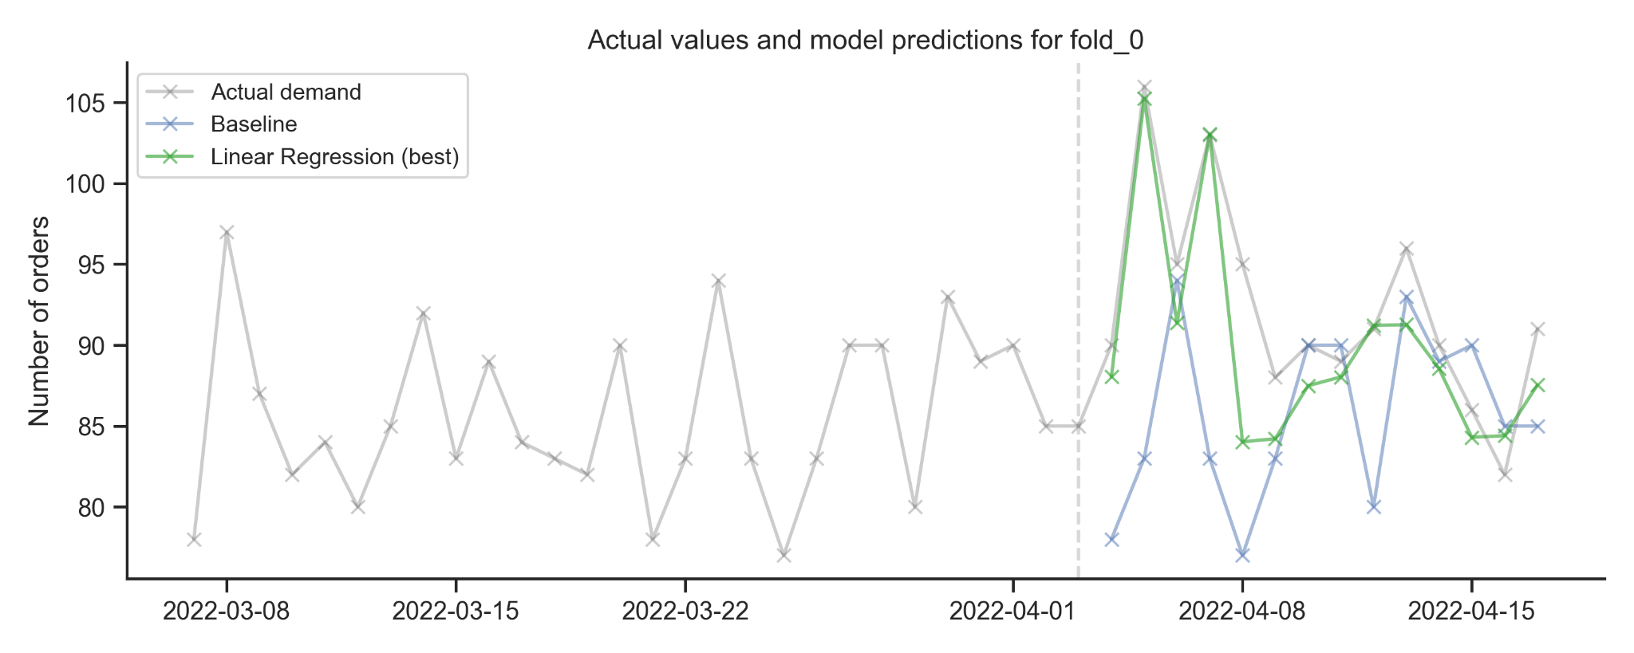
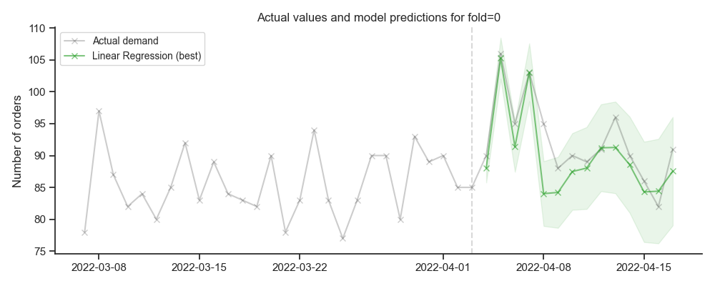
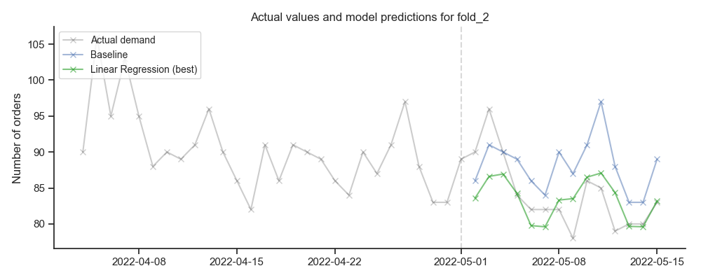
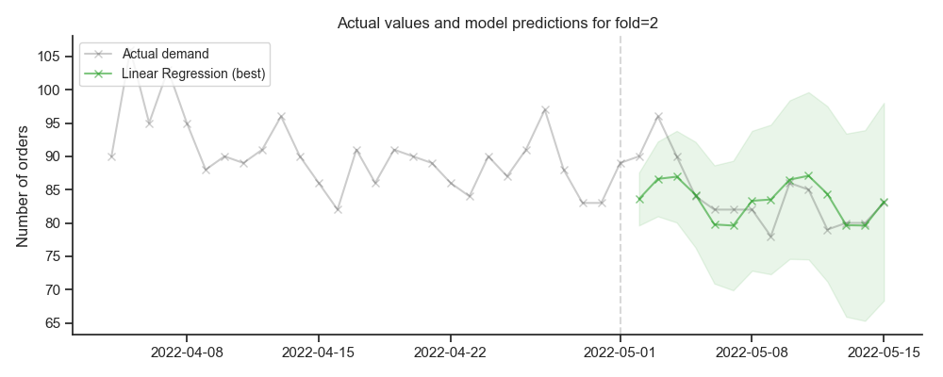
Linear regression forecast across different folds
Point forecast on the left and prediction intervals on the right

Slide 16
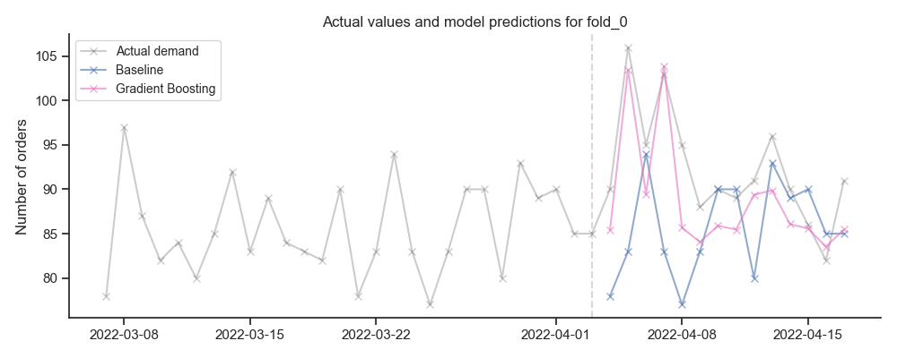
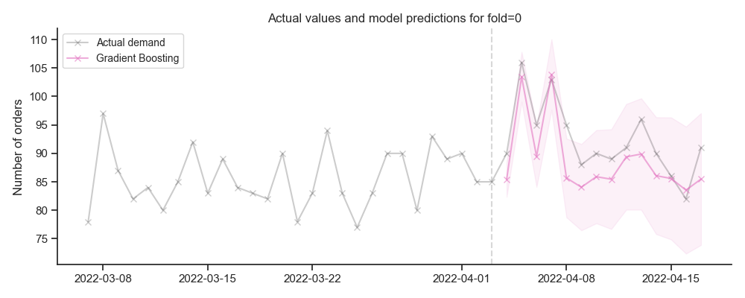
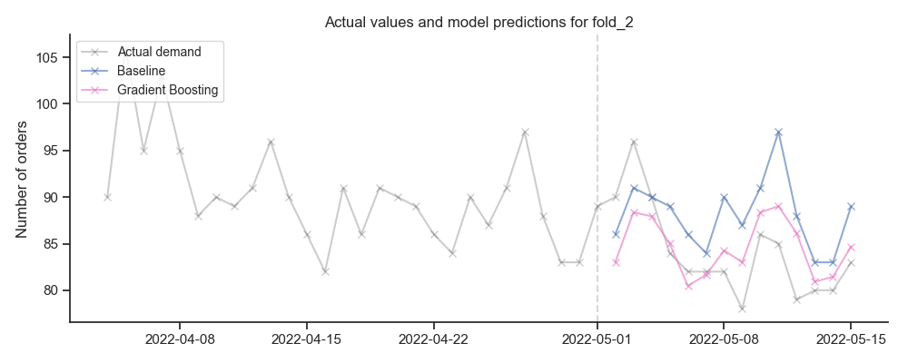
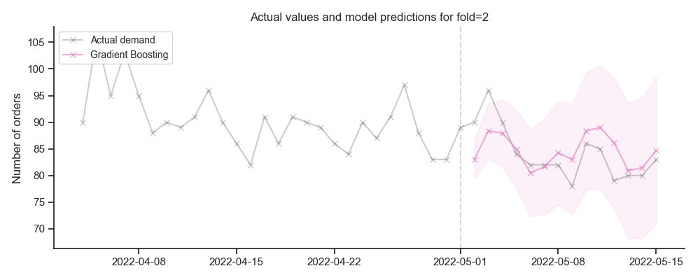
Gradient boosting forecast across different folds
Point forecast on the left and prediction intervals on the right

Slide 17
Model performance
Summary performance of the cross validation results
 | RMSE |  | MAPE |  | Bias |  | Coverage
Model | Train | Valid | Train | Valid | Train | Valid | Train | Valid
Benchmark | 9.66 | 8.77 | 9.30% | 7.78% | -0.81 | 0.07 | - | 0.93
LR - Integers | 7,70 | 6,44 | 7,57% | 5,93% | 0,78 | -0,09 | - | 0,91
LR - Ohe | 5,70 | 5,45 | 5,22% | 4,71% | 0,44 | -0,16 | - | 0,91
LR - Temp + Marketing | 4,82 | 4,62 | 4,62% | 3,96% | 0,35 | -0,14 | - | 0,94
Gradient Boosting | 4,41 | 4,68 | 4,35% | 4,19% | 0,45 | -0,15 | - | 0,93

Slide 18
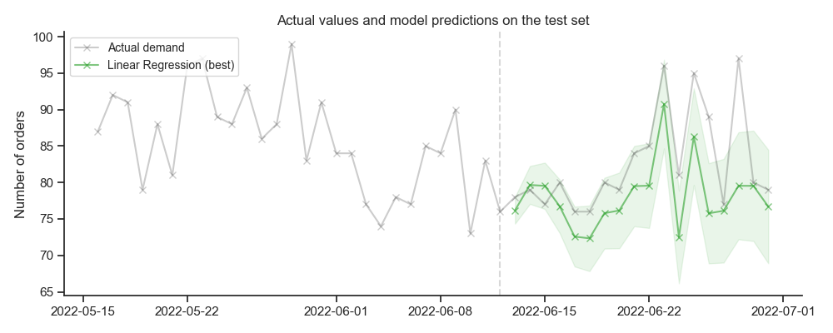
Test set evaluation
Predictions on the test set and performance metrics
RMSE: 6,6
MAPE: 5,73%
Coverage: 78%

Slide 19
Next steps and future work
Include in the EDA analysis of the ACF
Decompose the serie into trend, seasonality and residuals
Does any of the components correlate with temperature or marketing?
Explore other methods to correct outliers
Model seasonality with trigonometric features
Model marketing as suggested in the analysis
Include interactions in the linear regression model
Test other models
Fine tune parameters of the gradient boosting model
Analyze coefficients of the model to gain interpretability
Etc.

Slide 20
Thank you
Questions?

